Slide 1
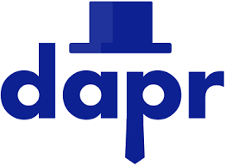
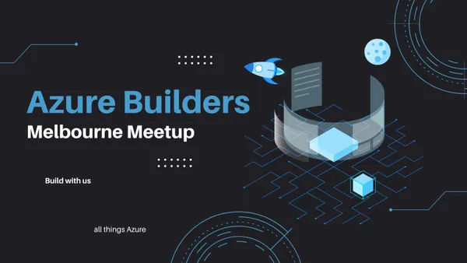
Portable Multi-cloud Apps with Dapr
Nilesh Gule @nileshgule

Slide 2

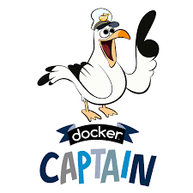


$whoami
{
“name” : “Nilesh Gule”,
“website” : “https://www.HandsOnArchitect.com",
“github” : “https://GitHub.com/NileshGule"
“twitter” : “@nileshgule”,
“linkedin” : “https://www.linkedin.com/in/nileshgule”,
“YouTube” : “https://www.YouTube.com/@nilesh-gule”
“likes” : “Technical Evangelism, Cricket”,
}

Slide 3
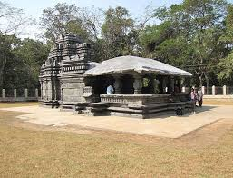
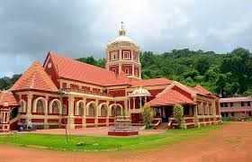
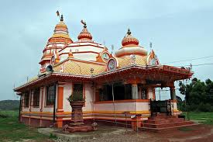

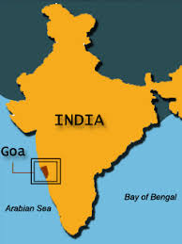







Slide 4
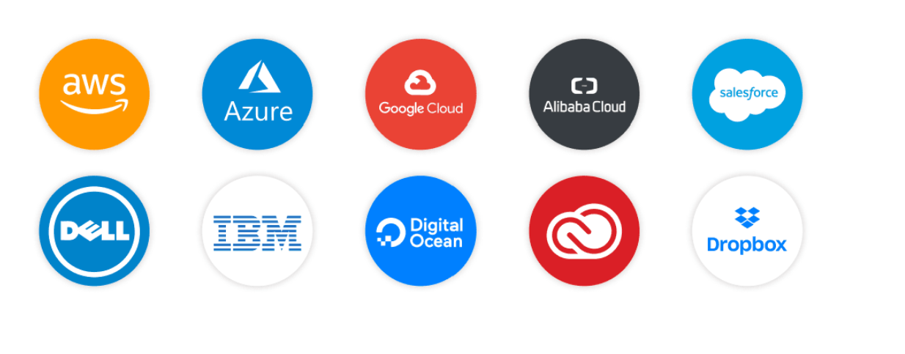
Top 10 Cloud providers
Benefits of using Cloud Technologies
Cost: Saves money for upfront costs for hardware and software
Speed: self-serve, pay as you go
Scalability: based on different parameters
Security: policies, technologies, and controls to protect app, data and infra
Reliable: HA & DR capabilities

Slide 5
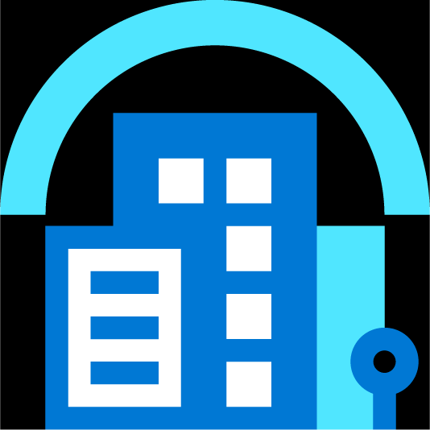
Cloud Native Apps
Cloud Computing
Specifically designed to take advantage of innovations in cloud computing
Infrastructure Innovations
Take advantage of innovations in infrastructure driven by cloud computing
Scaling
Integrate easily with respective cloud architectures, taking advantage of clouds resources and scaling capabilities
Cloud native platforms
Run apps in cloud providers datacenter and on cloud native platforms on-premise
Multi-cloud
Datacenter
Edge

Slide 6
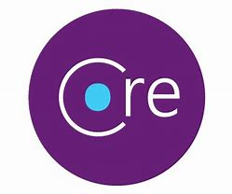
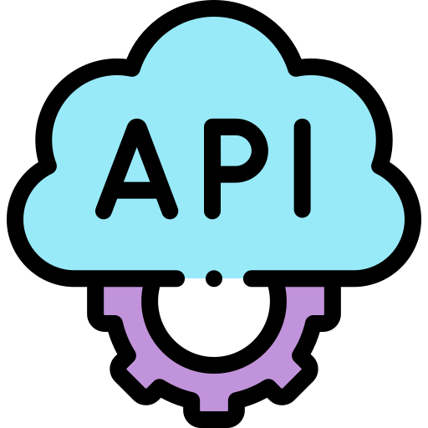

TechTalks Application Architecture – Without Dapr
New slide, need design consistency
TechTalks Producer
TechTalks Consumer
Message Broker

Slide 7
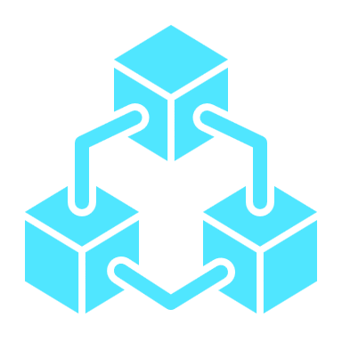
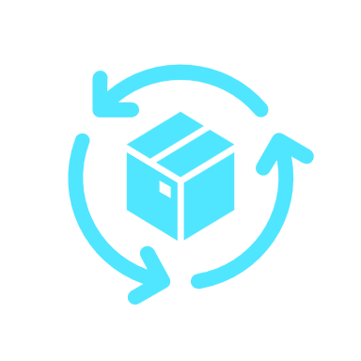
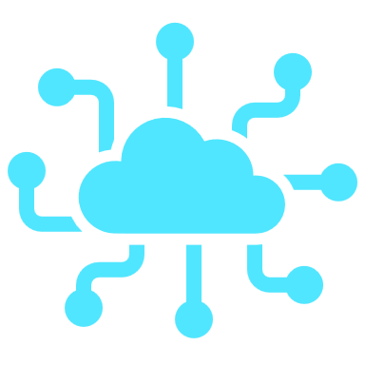



Features of Cloud Native Apps
Microservices
API driven
Containerized
Purpose driven modular components
Lightweight, self-contained
Loosely coupled, integrates using open standards
Resilient
Scalable
Automation
Self healing, recovers faster from failure
Cost optimized to run with right sized resources
Automates everything CI CD, Infrastructure as Code (IaC), GitOps

Slide 8
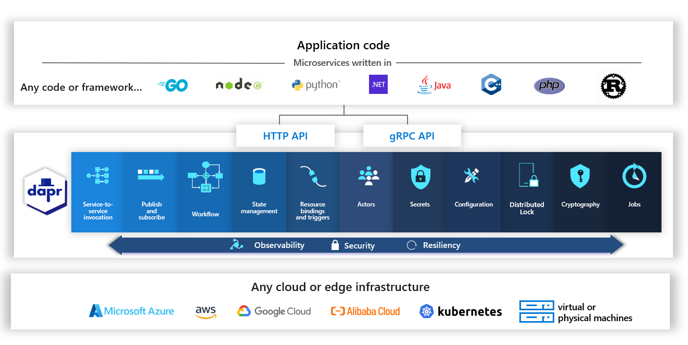
Dapr overview

Slide 9
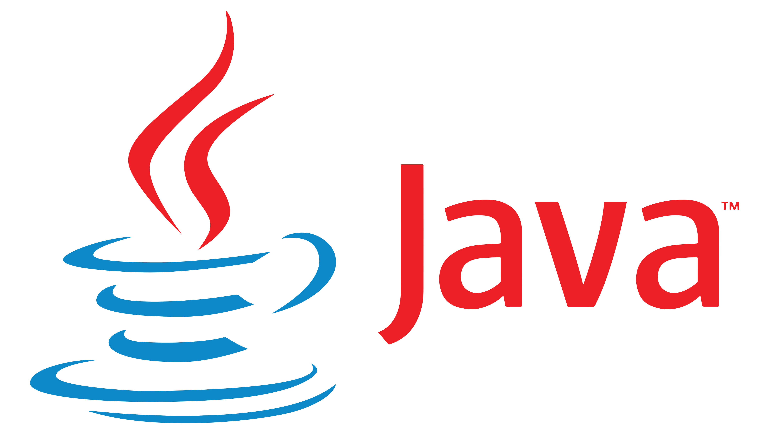


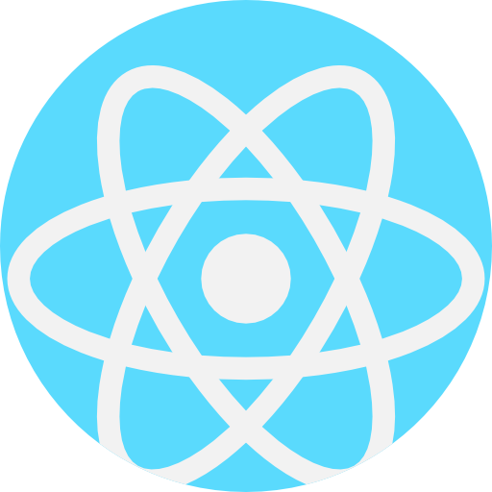
TechTalks Application Architecture – with Dapr
Polyglot
Programming
TechTalks Frontend (UI)
TechTalks Producer
TechTalks Consumer
Message Broker

Slide 10
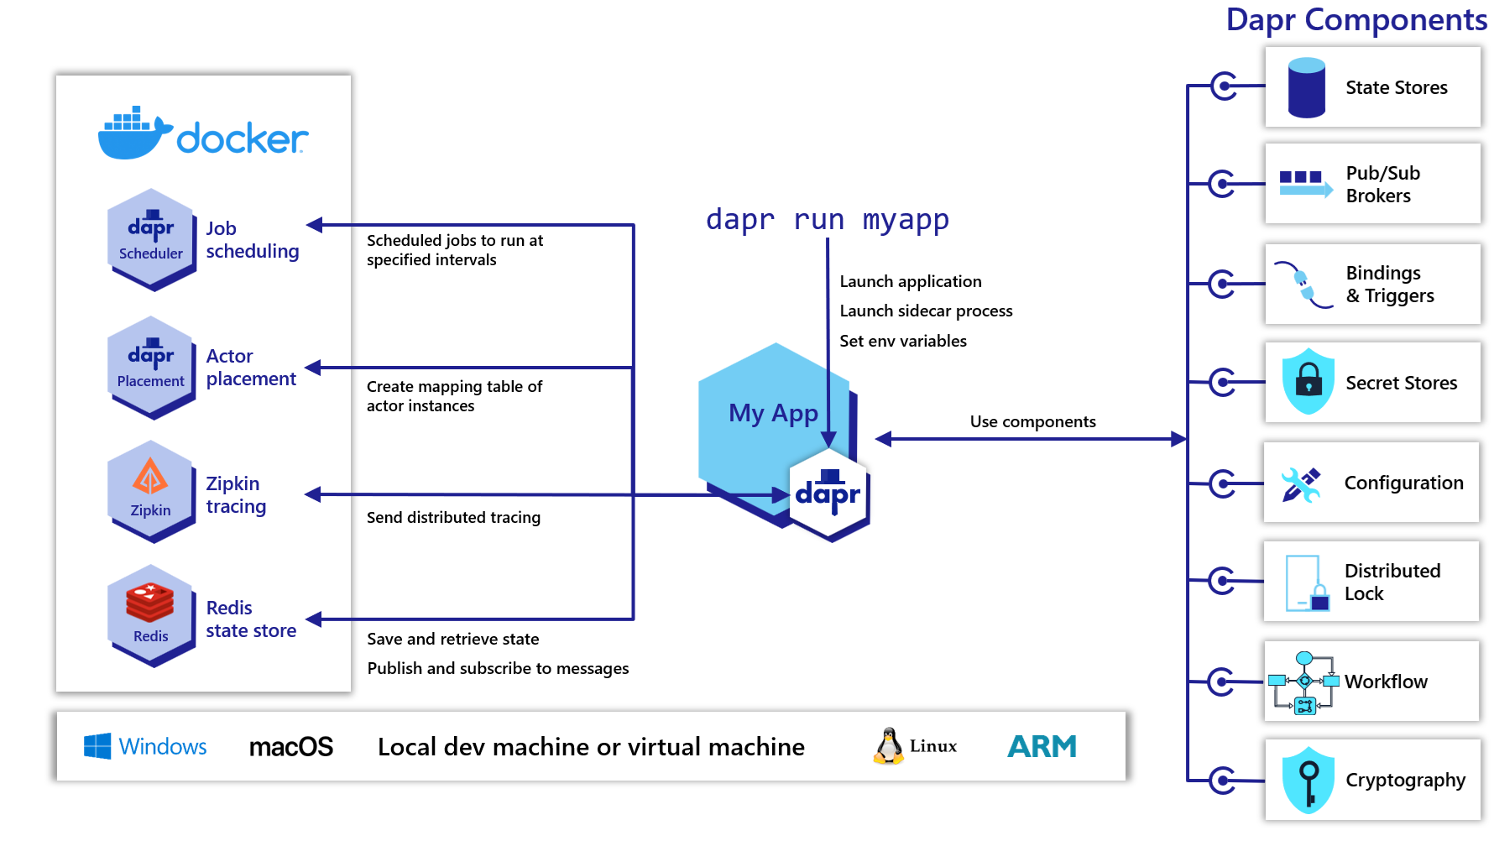
Dapr local development

Slide 11
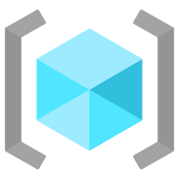


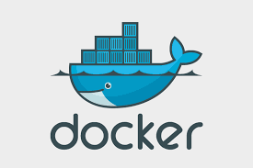
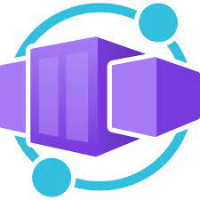
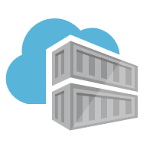

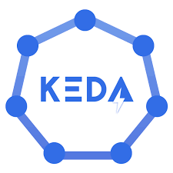
Azure Container Apps - TechTalks with Dapr
acrResourceGroup
azure-container-app-rg
aci-dev-env
Techtalks-producer
ngacrregistry
Techtalks-consumer

Slide 12

Let the messages flow

Slide 13
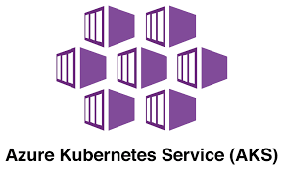
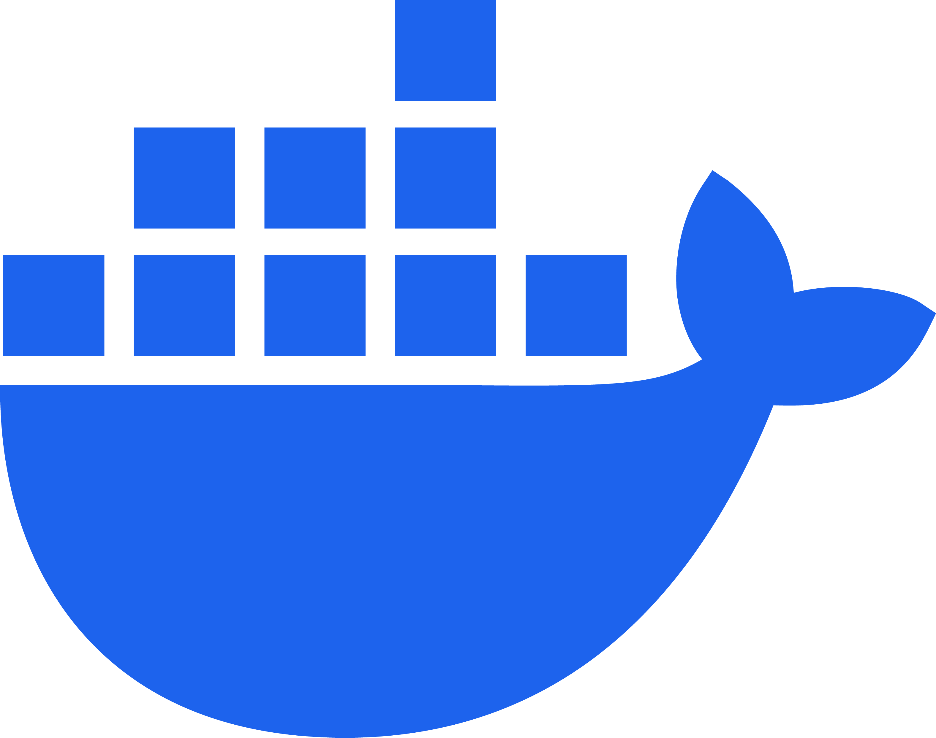
Azure Kubernetes Service - TechTalks with Dapr
acrResourceGroup
demo-azure-melbourne-rg
Techtalks-producer
ngacrregistry
Techtalks-consumer

Slide 14
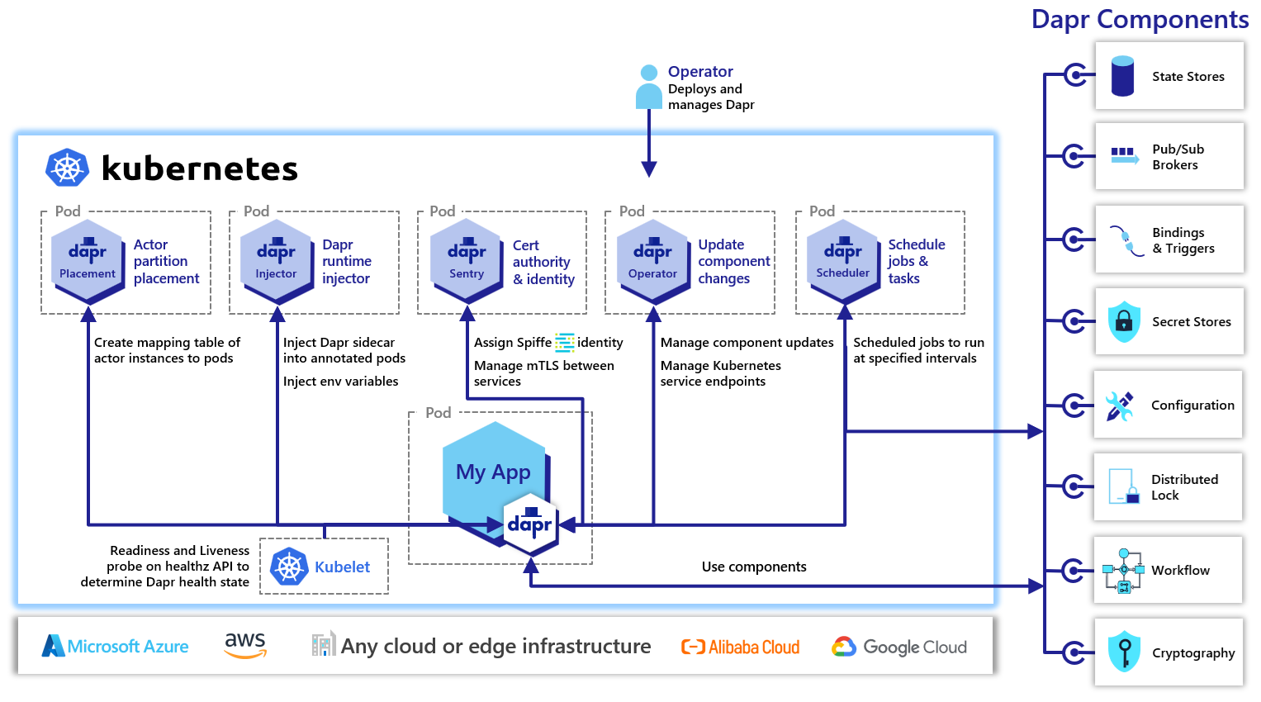
Dapr Kubernetes cluster

Slide 15
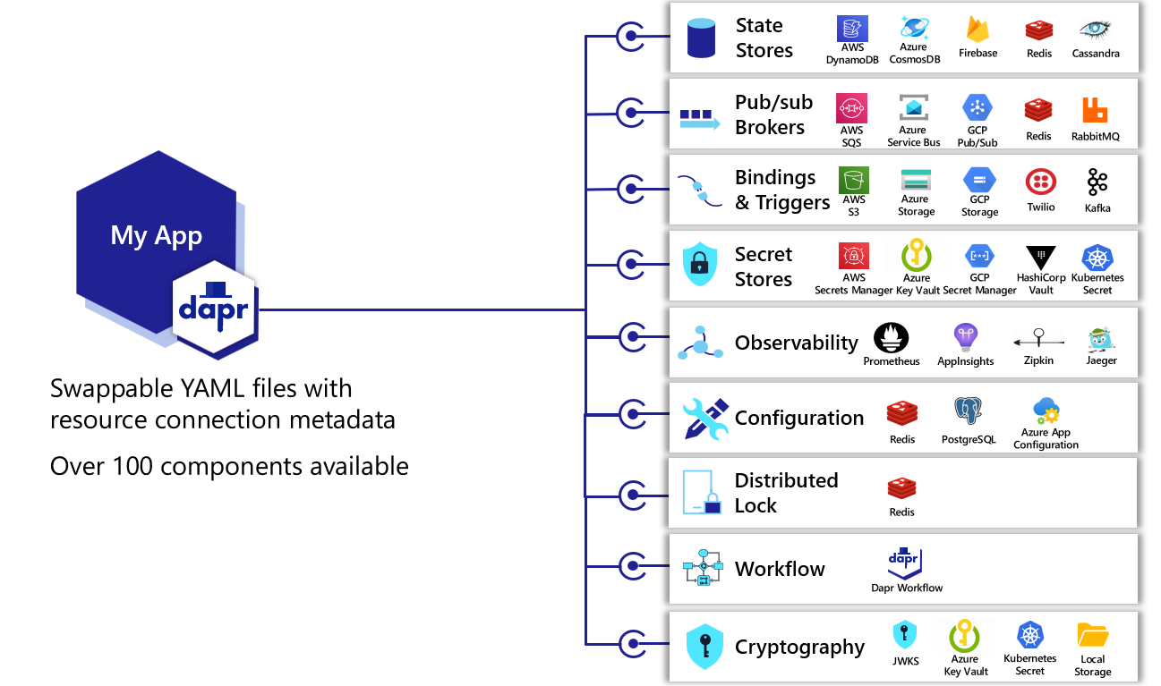
Dapr Components
https://docs.dapr.io/concepts/components-concept/#built-in-and-pluggable-components

Slide 16


app.UseCloudEvents();
client.PublishEventAsync(pubsubName, topicName, talk, cancellationToken);
app.UseCloudEvents();
app.MapSubscribeHandler();
app.MapPost("/process", ([FromBody] TechTalk techTalk) =>
}).WithTopic("rabbitmq-pubsub", "techtalks")
icons created by smashingstocks – Flaticon https://www.flaticon.com/free-icons/

Slide 17
client.publishEvent("rabbitmq-pubsub", "techtalks", techTalk, singletonMap(Metadata.TTL_IN_SECONDS, MESSAGE_TTL_IN_SECONDS)).block();
@Topic(pubsubName="rabbitmq-pubsub", name="techtalks")
@PostMapping(path = "/process", consumes = MediaType.ALL_VALUE)
public Mono<ResponseEntity> consumeMessage(@RequestBody(required = false) CloudEvent<TechTalk> cloudEvent) {
return Mono.fromSupplier(() -> {
try {
TimeUnit.MILLISECONDS.sleep(250);
TechTalk techtalk = cloudEvent.getData();
logTechTalkDetails(techtalk);
return ResponseEntity.ok("SUCCESS");
} catch (Exception e) {
throw new RuntimeException(e);
}
});
}
icons created by smashingstocks – Flaticon https://www.flaticon.com/free-icons/

Slide 18

client.PublishEvent(ctx, pubsubComponentName, pubsubTopic, techTalk);
var sub = &common.Subscription{
PubsubName: "rabbitmq-pubsub",
Topic: "techtalks",
Route: "/techtalks",
}
s := daprd.NewService(":" + appPort)
err := s.AddTopicEventHandler(sub, eventHandler)
icons created by smashingstocks – Flaticon https://www.flaticon.com/free-icons/

Slide 19
Why use Dapr
Any language, any framework, anywhere
Building blocks for cloud and edge
Multiple hosting environments
Language specific SDKs
C++, Go, Java, JavaScript, .NET, PHP, Python, Rust
Frameworks
ASP.NET Core, Spring Boot , Flask, Express
Designed for operations

Slide 20


Summary
Key benefits of Dapr
Dapr tries to simplify the Microservices development and deployment
Dapr Components help to extract underlying functionality and provides abstractions
Best practices related to cloud native applications
Build portable app to deploy on local laptop, public cloud (Azure / AWS), Private Cloud / PaaS (OpenShift), Hybrid cloud, multi cloud scenarios etc.
Make app portable to run in serverless as well as managed cloud services
Implement observability features to monitor apps

Slide 21
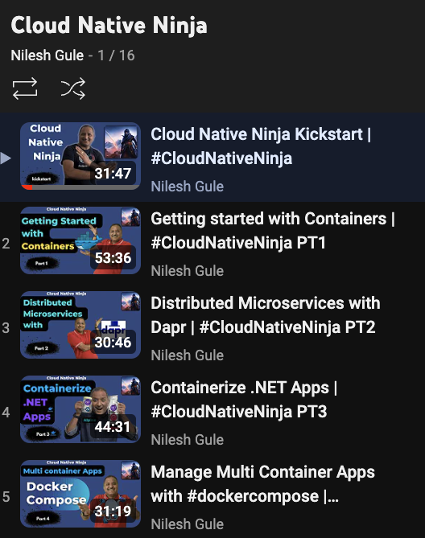
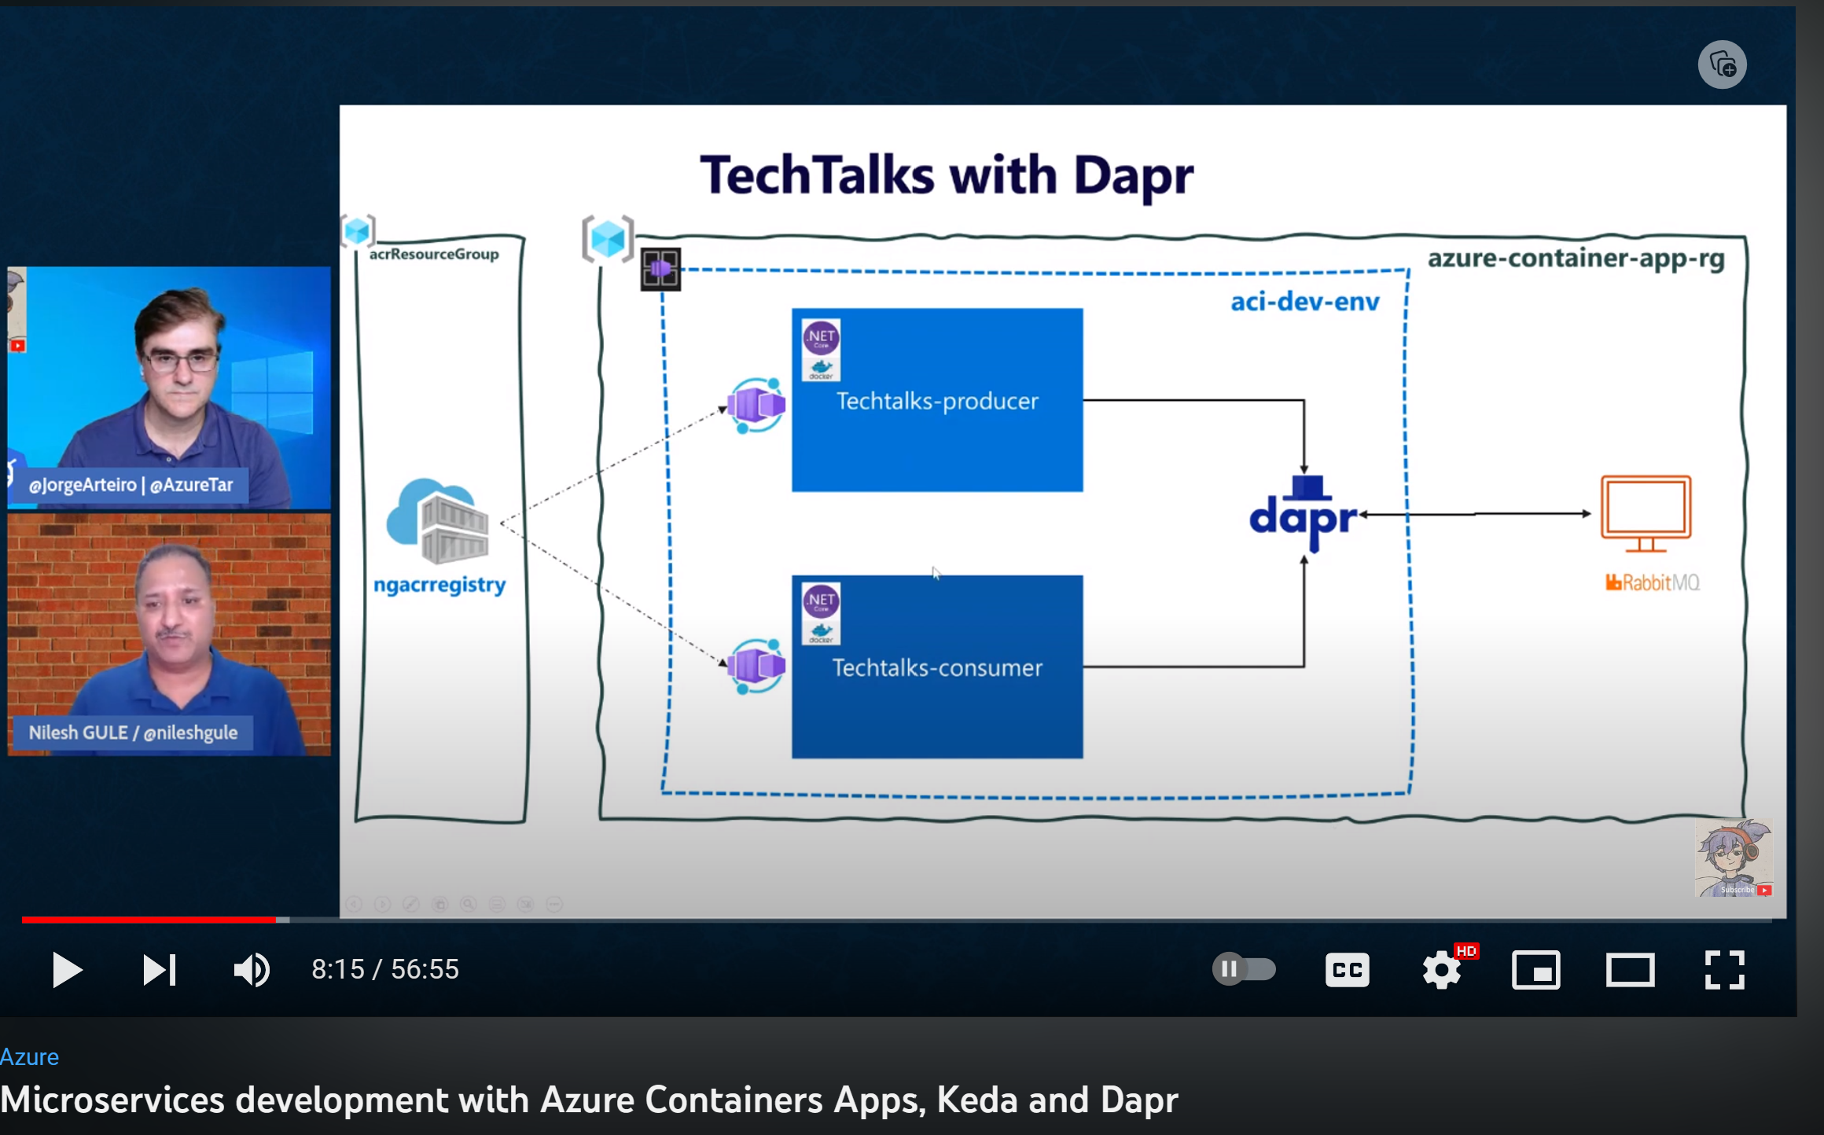
References
https://dapr.io/
Dapr Publish and Subscribe
Dapr Secrets management
Dapr in local environment
Dapr on Kubernetes
Dapr Quickstarts
Serverless - Dapr and Azure Container Apps
https://www.youtube.com/@nilesh-gule

Slide 22

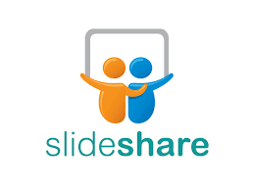

Dapr Demo Resources
Cloud Native Ninja GitHub repo: https://github.com/NileshGule/cloud-native-ninja
Azure container Apps repo: https://github.com/NileshGule/techtalks-azure-container-apps-demo
Initial version without Dapr repo: https://github.com/NileshGule/pd-tech-fest-2019
Slides
Slideshare: https://www.slideshare.net/nileshgule/
Speaker Deck: https://speakerdeck.com/nileshgule/

Slide 23






Nilesh Gule
https://www.youtube.com/@nilesh-gule
^{Architect | Microsoft MVP}
“Code with Passion and
Strive for Excellence”
NileshGule
nileshgule
@nileshgule
Nilesh Gule
www.handsonarchitect.com

Slide 24
Q&A

